Slide 1
Banking and Loan Experience
By: Giovanni Cortes
Alexander Torres
Darren Perez

Slide 2
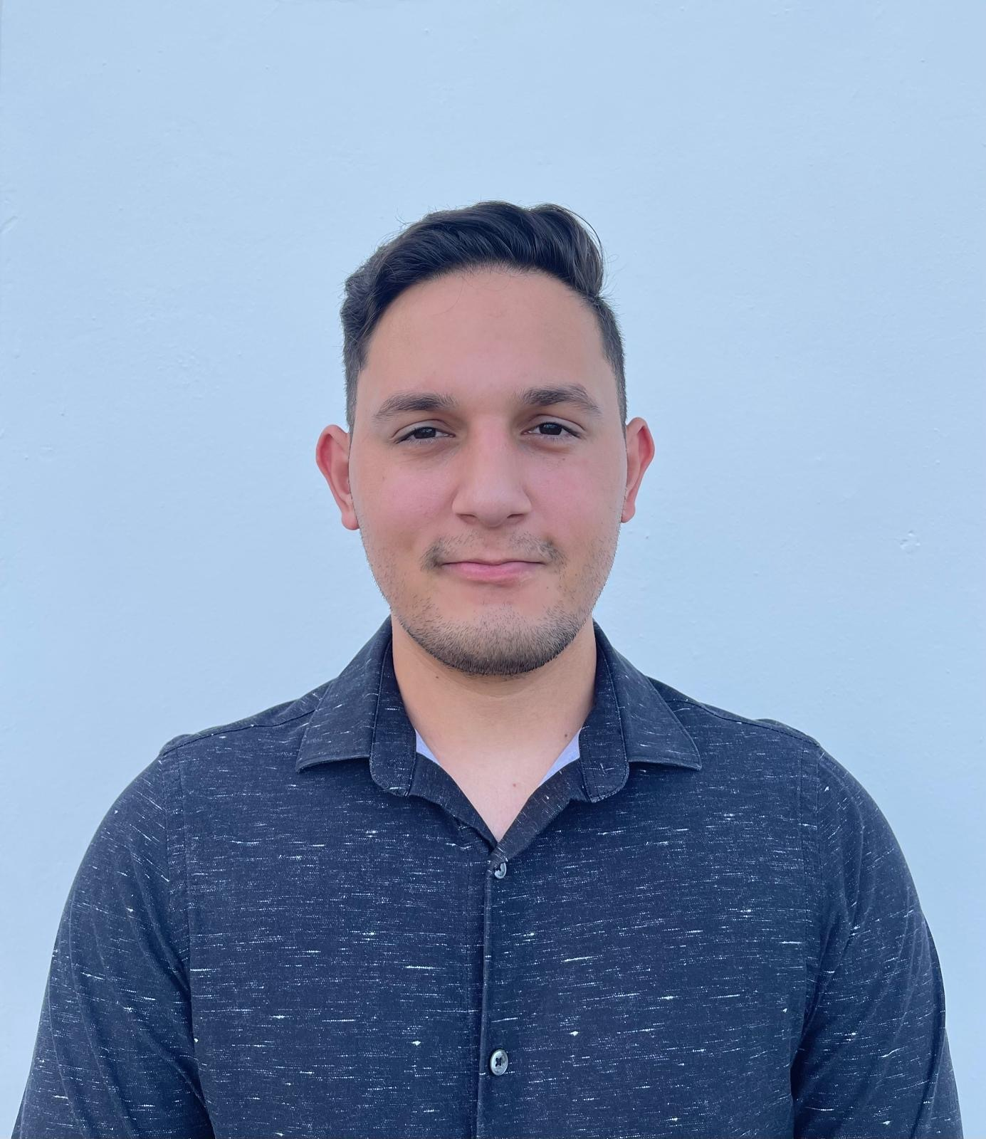
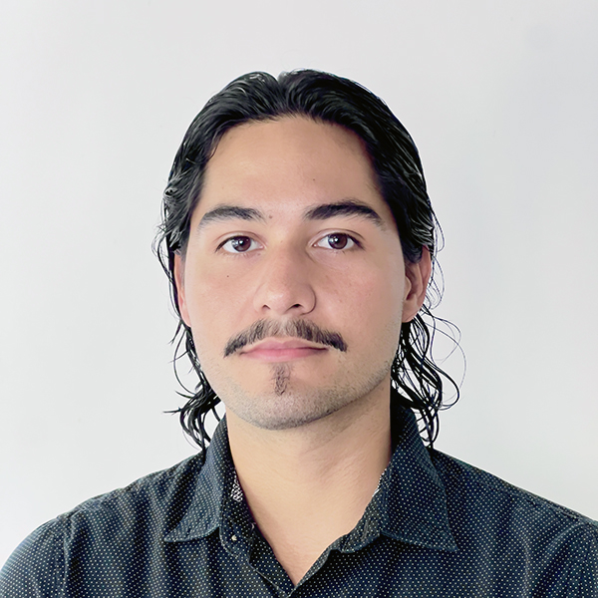

About Us
Darren Perez
Giovanni Cortes
Alexander Torres
From
Camuy
From
Guaynabo
From
Carolina
Volleyball Lover
Basketball Enthusiast
Videogame Lover

Slide 3
What do we bring?
01
02
03
Our project is designed to create a seamless experience for end users
Optimization for the loan request process to ensure efficiency and ease of use
The solution benefits both the bank and its clients by providing a better experience.

Slide 4
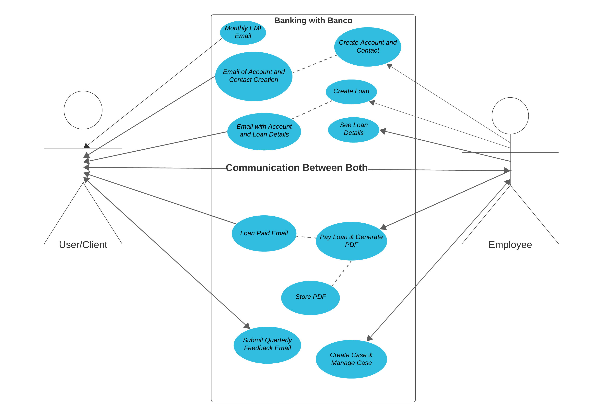
Work Behind the Scene

Slide 5

Why did we choose it?
This project was assigned to our team, and we embraced the challenge with expectation of enhancing our client and banking experience.

Slide 6

Biggest Challenge
Generating a loan document in PDF format and attaching it to the appropriate account in Salesforce.

Slide 7

Solution
Utilizing Account history for tracking, we were able to successfully implement this functionality.

Slide 8
Biggest Oops
Problem
What did we learn
Assuming there were no limits on the amount of emails our org could send, we unexpectedly hit Salesforce email limit and got blocked of making any more tests of our flows and batch services.
We discovered that Salesforce imposes daily email limits in Developer Edition orgs, including a maximum of 50 recipient addresses per day, with additional constraints on mass emails, List Emails, and workflow emails.

Slide 9
Demo

Slide 10
Thanks!
Banking and Loan Experience
From:
Giovanni Cortes
Alexander Torres
Darren Perez

